Slide 1

Introduction to Machine Learning
Supervised Learning
By <Trainer’s Name>
<Date>

Slide 2
What is Supervised Learning?
<Topic>

Slide 3



What is Supervised Learning?
In supervised learning, the machine learns from the labeled data, i.e., we already know the result of the input data
It is called as “Supervised” learning because the algorithm learns from a dataset. The goal is to make the algorithm’s output as accurate as possible when a new input is fed to it.
Notes:
The first question that arise in our mind is why Statistics?
Let me make you clear that Statistics is one of the key fundamental skills required for data science. Moving forward in the data science, if you go for any kind of algorithms then primarily knowledge in statistics is quite important. Actually, the statistics and probability are considered as the base knowledge and they are very essential for moving into any machine learning algorithms.

Slide 4


What is Supervised Learning?
Simple workflow of a supervised learning model
Supervisor
Training dataset
Desired output
Output
Input Raw Data
Algorithm
Processing
Notes:
The first question that arise in our mind is why Statistics?
Let me make you clear that Statistics is one of the key fundamental skills required for data science. Moving forward in the data science, if you go for any kind of algorithms then primarily knowledge in statistics is quite important. Actually, the statistics and probability are considered as the base knowledge and they are very essential for moving into any machine learning algorithms.

Slide 5
Linear Regression
<Topic>

Slide 6
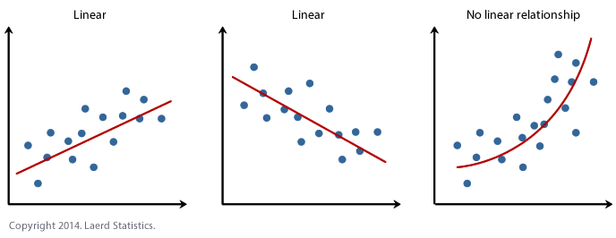
Linear Regression
Simple linear regression is useful for finding relationship between two continuous variables
One is predictor or independent variable and other is response or dependent variable

Slide 7
Linear Regression
Let us discuss linear regression with an example. We want to know how do the monthly charges of a customer vary with respect to tenure
Estimating the value of “Monthly Charges” with “Tenure” of the customer
100
80
60
Monthly Charges
40
20
10
20
30
40
50
60
70
Tenure

Slide 8
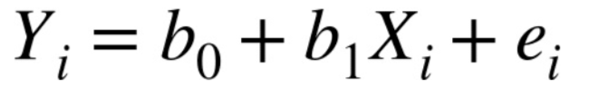
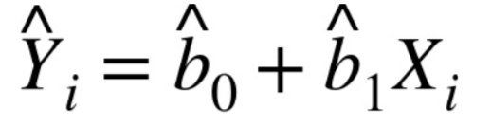
Linear Regression
In general, the data doesn’t fall exactly on a line, so the regression equation should include an implicit error term
The fitted values (predicted values) are typically denoted by Y-hat

Slide 9


Linear Regression
If b1 > 0, then x(predictor) and y(target) have a positive relationship.
That is increase in x will increase y.
b1 > 0
Positive Relationship
$$y=b_{0}+b_{1}x$$

Slide 10
Linear Regression
If b1 < 0, then x(predictor) and y(target) have a negative relationship.
That is increase in x will decrease y.
b1 < 0
Negative Relationship
$$y=b_{0}+b_{1}x$$

Slide 11
Linear Regression
What are Residuals?
The difference between the observed value of the dependent variable (y) and the predicted value (ŷ) is called the residual. Each data point has one residual
Residual
Salary
Age

Slide 12
Linear Regression
There could be multiple fit lines passing through the points, so how will you know which is the Line of best fit?
Line fit 1
Line fit 2
Line fit 3

Slide 13
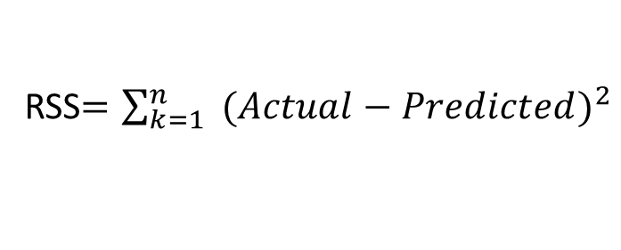
Linear Regression
The line with the lowest value of Residual sum of Squares would be the best fit line
RSS$=\sum_{k=1}^{n}{ (Actual−Predicted)^{2}}$
RSS = 120
RSS = 80
RSS = 132

Slide 14
Linear Regression
Understanding Linear Regression through Example
Y
+ve
Dependent Variable
X
Independent Variable

Slide 15
Linear Regression
Understanding Linear Regression through Example
Y
Dependent Variable
-ve
X
Independent Variable

Slide 16
Linear Regression
Understanding Linear Regression through Example
Y
Line
Dependent Variable
X
Independent Variable

Slide 17
Linear Regression
Understanding Linear Regression through Example
Y
Line of Linear Regression
Dependent Variable
X
Independent Variable

Slide 18
Linear Regression
Understanding Linear Regression through Example
Y
Dependent Variable
Observation
X
Independent Variable

Slide 19
Linear Regression
Understanding Linear Regression through Example
Y
Regression Line
Least Square Method
Dependent Variable
X
Independent Variable

Slide 20
Linear Regression
Understanding Linear Regression through Example
Y
Estimated Value
error
Dependent Variable
error
Actual Value
X
Independent Variable

Slide 21
Linear Regression
Understanding Linear Regression through Example
Y
Dependent Variable
Minimize the error
X
Independent Variable

Slide 22
Linear Regression
Understanding Linear Regression through Example
Y
+ve Relationship
Distance
X
Speed

Slide 23
Linear Regression
Understanding Linear Regression through Example
Y
y = mx + c
Distance
Distance travelled in a fixed duration of time
X
Speed

Slide 24
Linear Regression
Understanding Linear Regression through Example
Y
Speed of Vehicle
y = mx + c
Distance
X
Speed

Slide 25
Linear Regression
Understanding Linear Regression through Example
Y
y = mx + c
Distance
m = +ve slope of line
X
Speed

Slide 26
Linear Regression
Understanding Linear Regression through Example
Y
y = mx + c
Distance
c = y - intercept of the line
X
Speed

Slide 27
Linear Regression
Understanding Linear Regression through Example
Y
y = - mx + c
Distance
Time taken to travel a fixed distance
-ve Relationship
X
Speed

Slide 28
Linear Regression
Understanding Linear Regression through Example
Y
Independent Variable
y = mx + c
Distance
Dependent Variable
X
Speed

Slide 29

Linear Regression
Mean Square Error
Y
Dependent Variable
m = 0.1
c = 3.3
y = 0.1x + 3.3
5
4
For given m = 0.1 & c = 3.3 ,
Lets predict values for y when
x = {1,2,3,4,5}
3
2
y = 0.1 x 1+ 3.3 = 3.2
y = 0.1 x 2+ 3.3= 3.1
y = 0.1 x 3+ 3.3= 3.0
y = 0.1 x 4+ 3.3= 2.9
y = 0.1 x 5+ 3.3= 2.8
1
0
1
2
4
5
6
X
Independent Variable
3

Slide 30
Linear Regression
Mean Square Error
Y
Dependent Variable
m = 0.1
c = 3.3
y = 0.1x + 3.3
5
4
Line of Regression
For given m = 0.1 & c = 3.3 ,
Lets predict values for y when
x = {1,2,3,4,5}
3
2
y = 0.1 x 1+ 3.3 = 3.2
y = 0.1 x 2+ 3.3= 3.1
y = 0.1 x 3+ 3.3= 3.0
y = 0.1 x 4+ 3.3= 2.9
y = 0.1 x 5+ 3.3= 2.8
1
0
1
2
3
4
5
6
X
Independent Variable

Slide 31
Linear Regression
Finding the best fit line

Slide 32
Linear Regression
Goodness of Fit – 𝑹^𝟐
R-Squared is interpreted as the proportion of the variance in the dependent variable that is predictable from the independent variable
An R Squared of 0 means that the dependent variable cannot be predicted from the independent variable
An R Squared of 1 means the dependent variable can be predicted without error from the independent variable
An R Squared between 0 and 1 indicates the extent to which the dependent variable is predictable. An R Squared of 0.10 means that 10 percent of the variance in Y is predictable from X; an R Squared of 0.20 means that 20 percent is predictable; and so on

Slide 33
Linear Regression
Adjusted R Squared
1
The adjusted R-squared is a modified version of R-squared that has been adjusted for the number of predictors in the model
2
The adjusted R-squared increases only if the new term improves the model more than would be expected by chance
3
Adjusted R Squared will always be less than or equal to R Squared

Slide 34
Multiple Linear Regression
<Topic>

Slide 35

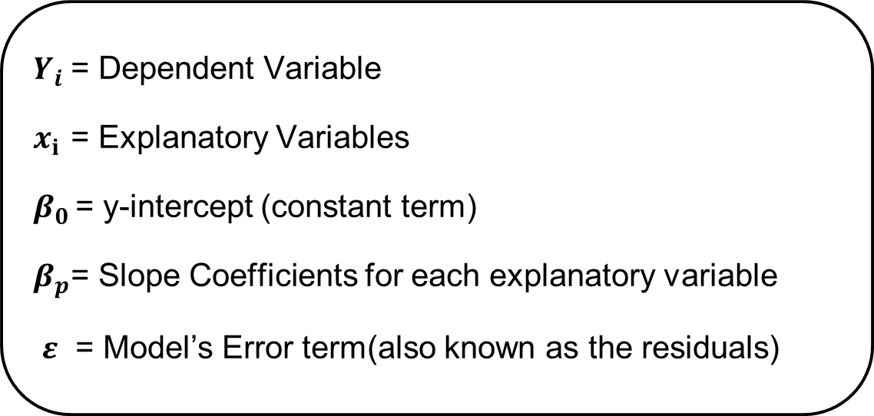
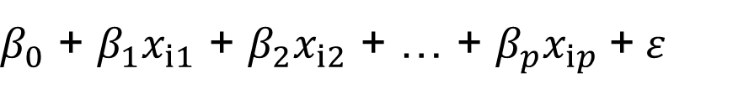
Multiple Linear Regression
Multiple Linear Regression uses several explanatory variables to predict the outcome of a response variable. We call it “multiple” because in this case, unlike simple linear regression, we have many independent variables trying to predict a dependent variable
Formula for Multiple Linear Regression:
$$Y_{i}=$$
$β_{0}$ + $β_{1}x_{i1}$ + $β_{2}x_{i2}$ + … + $β_{p}x_{ip}$+$ε$
$Y_{i}$= Dependent Variable
$x_{i }$= Explanatory Variables
$β_{0 }$= y-intercept (constant term)
$β_{p}$= Slope Coefficients for each explanatory variable
$ε$ = Model’s Error term(also known as the residuals)

Slide 36
Multiple Linear Regression
Understanding Multiple Linear Regression through Example
You own a company and you want to know how your employees’ job performance relates to their IQ, their motivation and the amount of social support they receive
Motivation
IQ
Social Support
Job Performance

Slide 37

Multiple Linear Regression
Understanding Multiple Linear Regression through Example
But, Regression Analysis, provides numeric estimates of the strengths of such relations. In order to use regression analysis, we need data on the four variables (1 criterion and 3 predictors) in our model. We therefore have our employees take some tests that measure these
So, here we see that, ‘Intelligence Quotient’, ‘Motivation’
& ‘Social Support’ have been measured in numerical form

Slide 38
Multiple Linear Regression
Understanding Multiple Linear Regression through Example
Now, let’s apply linear regression on this data and find the 𝛽 Coefficients
Motivation
0.31
Job Performance = (0.31*Motivation) + (0.16*IQ) + (0.27*Social Support) + 18.1
IQ
0.16
Social Support
0.27
The formula shows how job performance is estimated: we add up each of the predictor scores after multiplying them with some number. These numbers are known as the b coefficients or unstandardized regression coefficients
Constant
18.1
Job Performance

Slide 39
Multiple Linear Regression
Understanding Multiple Linear Regression through Example
Motivation
0.31
IQ
0.16
In this model, 18.1 is a baseline score that's unrelated to any other variable. It's a constant over respondents, which means that, it's the same 18.1 points for each respondent.
Social Support
0.27
Constant
18.1
Job Performance

Slide 40
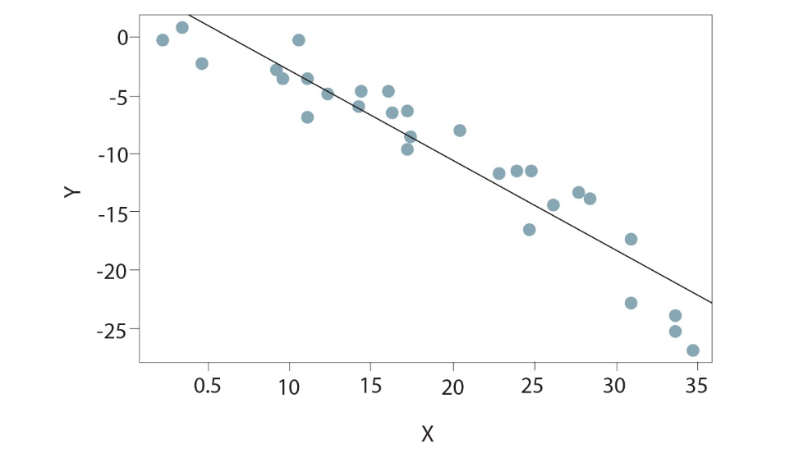
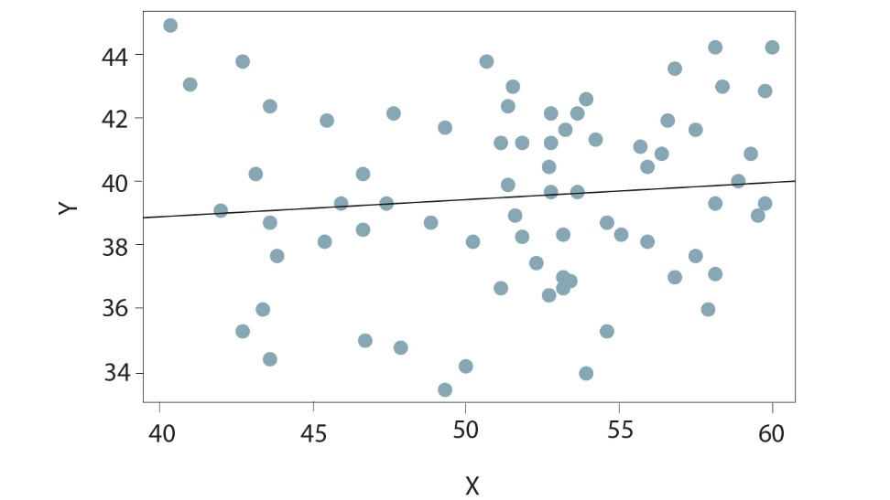

Multiple Linear Regression
1
There should be a linear and additive relationship between the dependent and independent variables
Satisfies the assumption
Doesn’t satisfy the assumption

Slide 41
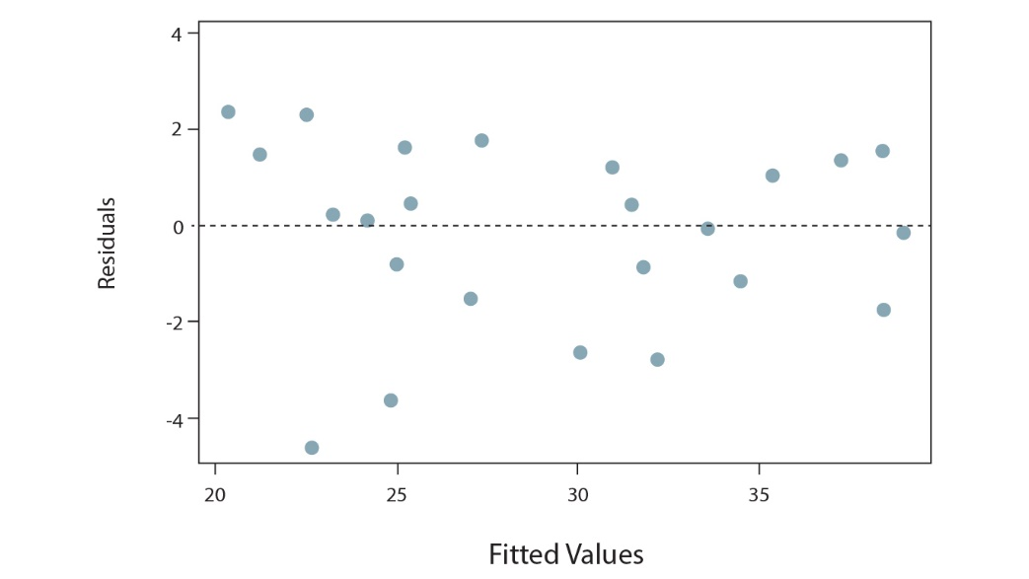
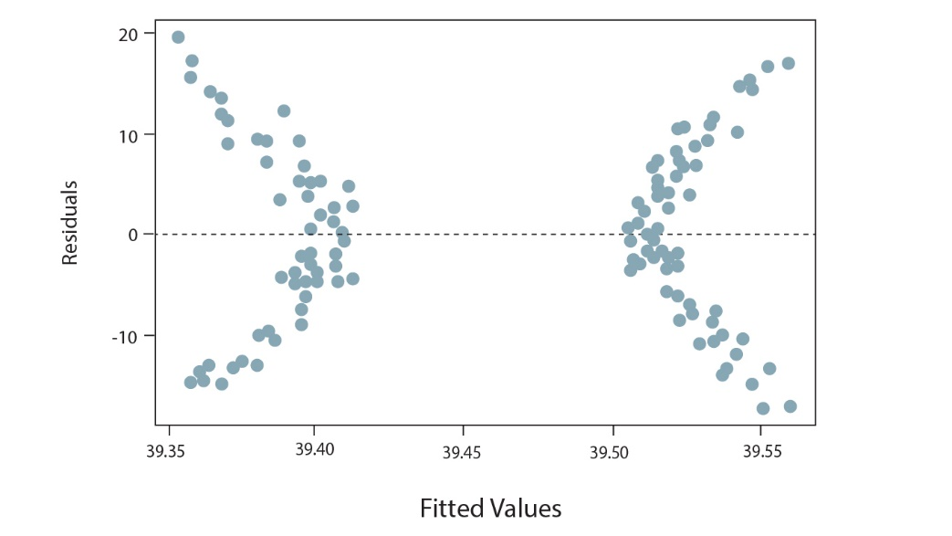
Multiple Linear Regression
2
The residuals must have constant variance
If there is no pattern, data is random and hence, satisfies the condition
If there is a pattern, the data is not random and hence, doesn’t satisfy the condition

Slide 42
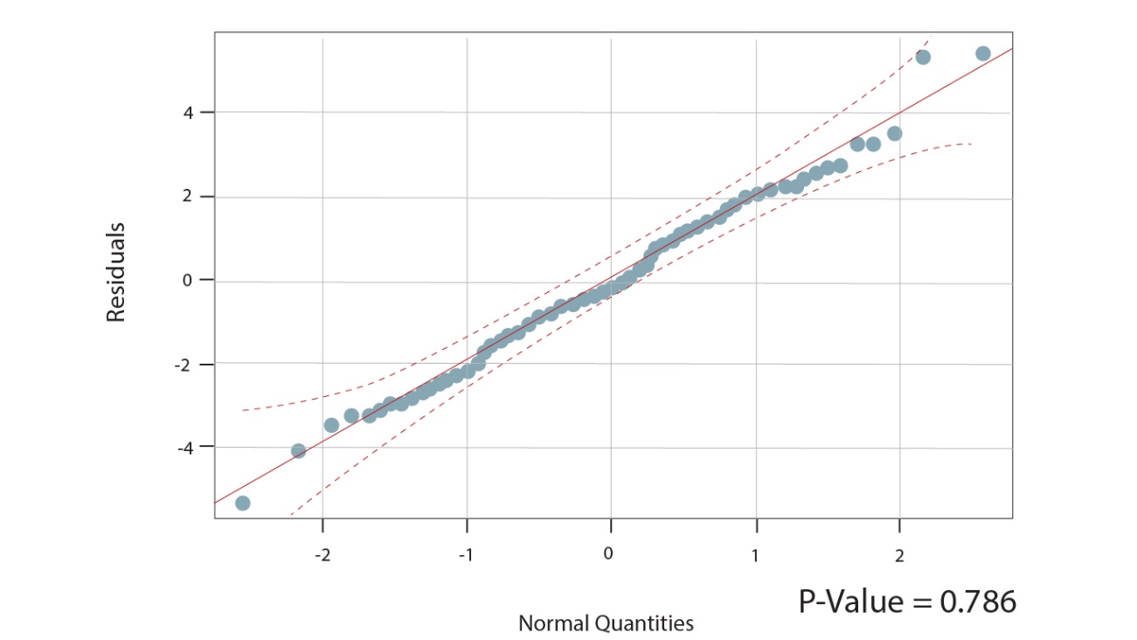
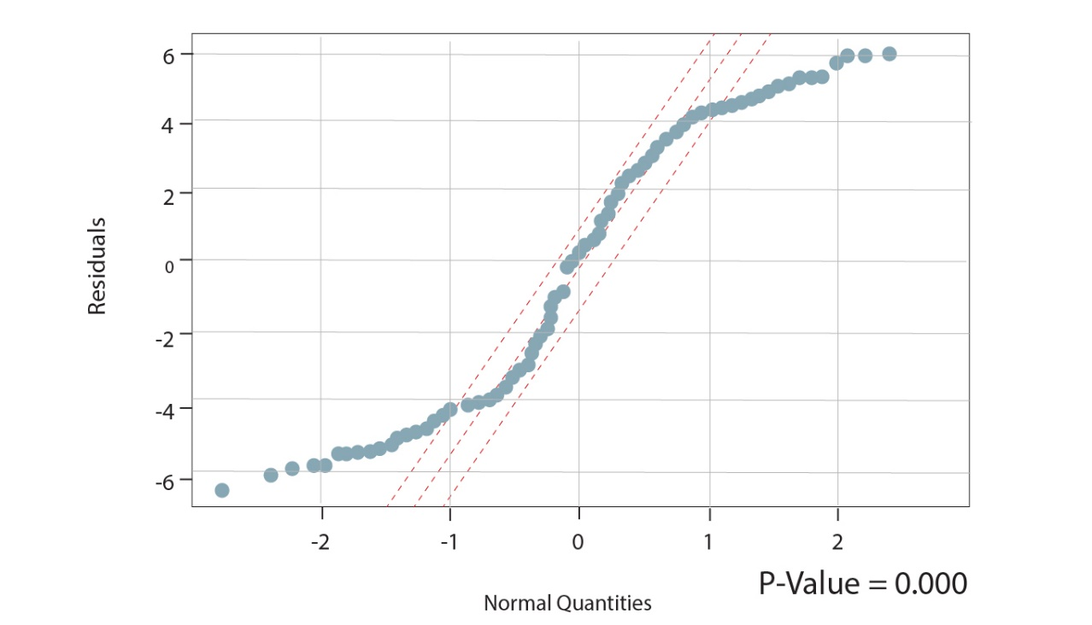
Multiple Linear Regression
3
The residuals must be normally distributed

Slide 43


Thank You

